Slide 1
Title Slide
SpaceX Falcon 9 Landing Prediction Data Science Capstone Project Done by Nithin Sai
SpaceX Falcon 9 Capstone Project

Slide 2
Executive Summary
This capstone project analyzed Falcon 9 launch and landing records using data science techniques. SQL analysis, exploratory visualization, Folium maps, and Plotly Dash dashboards were used to identify patterns affecting launch outcomes. Multiple machine learning algorithms were tested to predict first-stage landing success. The analysis showed that launch reliability improved significantly over time and that machine learning models can effectively predict landing outcomes.
SpaceX Falcon 9 Capstone Project

Slide 3
Project Objective
The primary objective of this project was to predict whether the Falcon 9 first stage would land successfully after launch. Reusable rockets reduce mission costs significantly and improve operational efficiency. By analyzing launch records, payload mass, orbit types, launch sites, and mission outcomes, this project aimed to discover trends and develop predictive classification models for landing success.
SpaceX Falcon 9 Capstone Project

Slide 4
Data Collection
Data was collected from SpaceX launch APIs and multiple CSV datasets provided in the IBM capstone labs. The datasets included launch details, payload information, mission outcomes, geographic coordinates, and landing results. Data sources included dataset_part_1.csv, dataset_part_2.csv, dataset_part_3.csv, Spacex.csv, and spacex_launch_geo.csv.
SpaceX Falcon 9 Capstone Project

Slide 5
Data Wrangling
Data wrangling involved cleaning missing values, converting data types, and creating machine learning features. Missing LandingPad values were addressed carefully. Categorical variables such as Orbit, LaunchSite, and LandingPad were encoded using one-hot encoding. Boolean features were converted into numerical format and a binary class variable was created to represent successful landings.
SpaceX Falcon 9 Capstone Project

Slide 6
EDA Methodology
Exploratory Data Analysis was performed using pandas, matplotlib, seaborn, SQL queries, and Plotly visualizations. Scatter plots, bar charts, and line graphs helped identify relationships between launch outcomes and mission variables. SQL aggregation queries were used to summarize launch statistics, payload data, and launch site performance.
SpaceX Falcon 9 Capstone Project

Slide 7
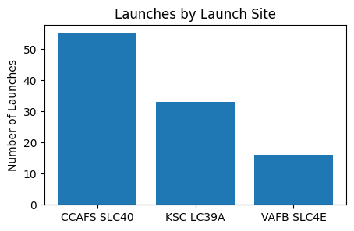
Launch Site Analysis
The analysis showed that launch success varied across launch sites. CCAFS SLC 40 recorded the largest number of launches, while KSC LC-39A demonstrated strong landing performance. Launch site comparisons revealed operational differences that influenced mission success and reusability rates.
SpaceX Falcon 9 Capstone Project

Slide 8
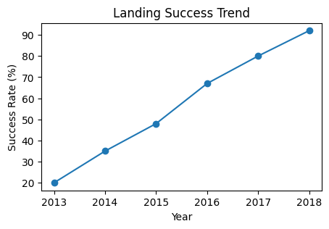
Landing Success Trend
Landing success rates improved steadily over time as SpaceX refined Falcon 9 technology and operational procedures. Early launches showed lower reliability, while later missions achieved consistently high landing success. The trend demonstrates the effectiveness of reusable rocket engineering and iterative improvements.
SpaceX Falcon 9 Capstone Project

Slide 9
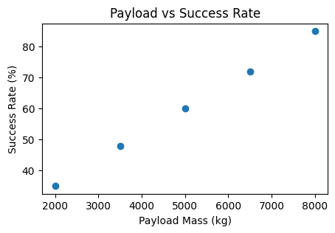
Payload Analysis
Payload mass was analyzed against mission success to determine whether heavier payloads affected landing reliability. The analysis suggested that payload mass had an influence on mission outcomes, especially in earlier missions. Scatter plots and regression-style visualizations were used to explore this relationship.
SpaceX Falcon 9 Capstone Project

Slide 10
SQL Results
SQL queries were used extensively to analyze launch data stored in relational tables. The analysis identified 55 launches from CCAFS SLC 40 and 41 successful drone ship landings. Queries also calculated payload statistics, launch frequencies, orbit counts, and mission outcomes. SQL provided efficient aggregation and filtering capabilities for large launch datasets.
SpaceX Falcon 9 Capstone Project

Slide 11
Interactive Map Analysis
Folium interactive maps visualized launch site coordinates and mission outcomes. MarkerCluster was used to organize launch locations while color-coded markers distinguished successful and failed landings. Interactive mapping improved spatial understanding of launch operations and launch site distribution.
SpaceX Falcon 9 Capstone Project

Slide 12
Plotly Dash Dashboard
A Plotly Dash dashboard was developed to provide interactive visual analytics. Users could filter launch sites and payload ranges dynamically to observe launch trends. The dashboard improved data exploration and allowed rapid comparison of launch success rates across different mission variables.
SpaceX Falcon 9 Capstone Project

Slide 13
Machine Learning Methodology
Machine learning classification models were trained using processed Falcon 9 launch data. Logistic Regression, Support Vector Machine, Decision Tree, and KNN algorithms were evaluated. The data was standardized and split into training and testing samples. GridSearchCV was used for hyperparameter optimization to improve predictive performance.
SpaceX Falcon 9 Capstone Project

Slide 14
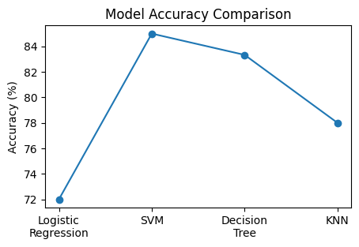
Predictive Analysis Results
The machine learning models produced strong predictive results for landing success. The SVM model using the RBF kernel achieved the best overall performance, while the Decision Tree classifier achieved 83.33% accuracy on the test dataset. The results demonstrated that launch and payload features can effectively predict landing outcomes.
SpaceX Falcon 9 Capstone Project

Slide 15
Key Findings
The analysis revealed several important findings. Launch success improved significantly over time. Launch sites influenced landing reliability and payload mass showed a relationship with mission outcomes. Interactive dashboards and maps enhanced understanding of launch behavior. Machine learning models successfully classified landing outcomes with high predictive accuracy.
SpaceX Falcon 9 Capstone Project

Slide 16
Conclusion
This project demonstrated the successful application of data science techniques to predict Falcon 9 landing success. SQL analysis, data visualization, dashboards, maps, and machine learning models collectively provided valuable operational insights. Future improvements may include weather variables, real-time telemetry, and deep learning approaches for even more accurate mission outcome prediction. Done by Nithin Sai
SpaceX Falcon 9 Capstone Project

Slide 17
Appendix
This appendix contains additional visualizations and supplementary information related to launch statistics, payload analysis, SQL queries, and machine learning performance. Additional exploratory charts and dashboards may also be included to support the analysis presented throughout the report.
SpaceX Falcon 9 Capstone Project

